Slide 1
🔐 Microsoft Entra ID Protection – User Risk Policy Demo
Real-Time Identity Protection in Action
Perparim Abdullahu – AZ-305 Certified | SC-300 in Progress

Slide 2
What Is Microsoft Entra ID Protection?
Entra ID Protection uses machine learning to detect risky behavior like:
Leaked credentials
TOR-based or unfamiliar sign-ins
Impossible travel
It works with Conditional Access to:
Require MFA
Block access
Trigger admin response

Slide 3
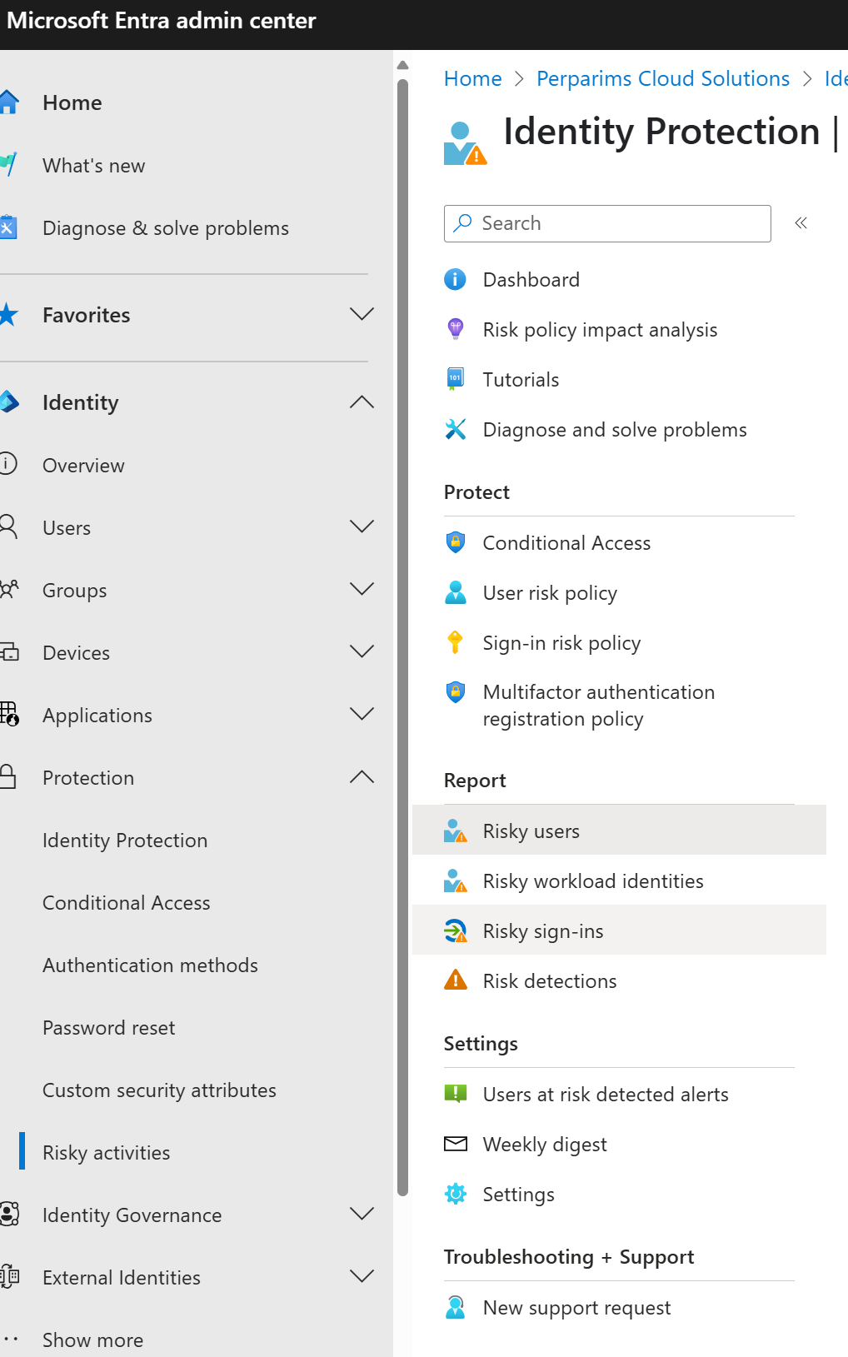
Navigating to Identity Protection
Go to Microsoft Entra Admin Center ➜ Protection ➜ Identity Protection This dashboard shows active detections, policies, and reports.

Slide 4
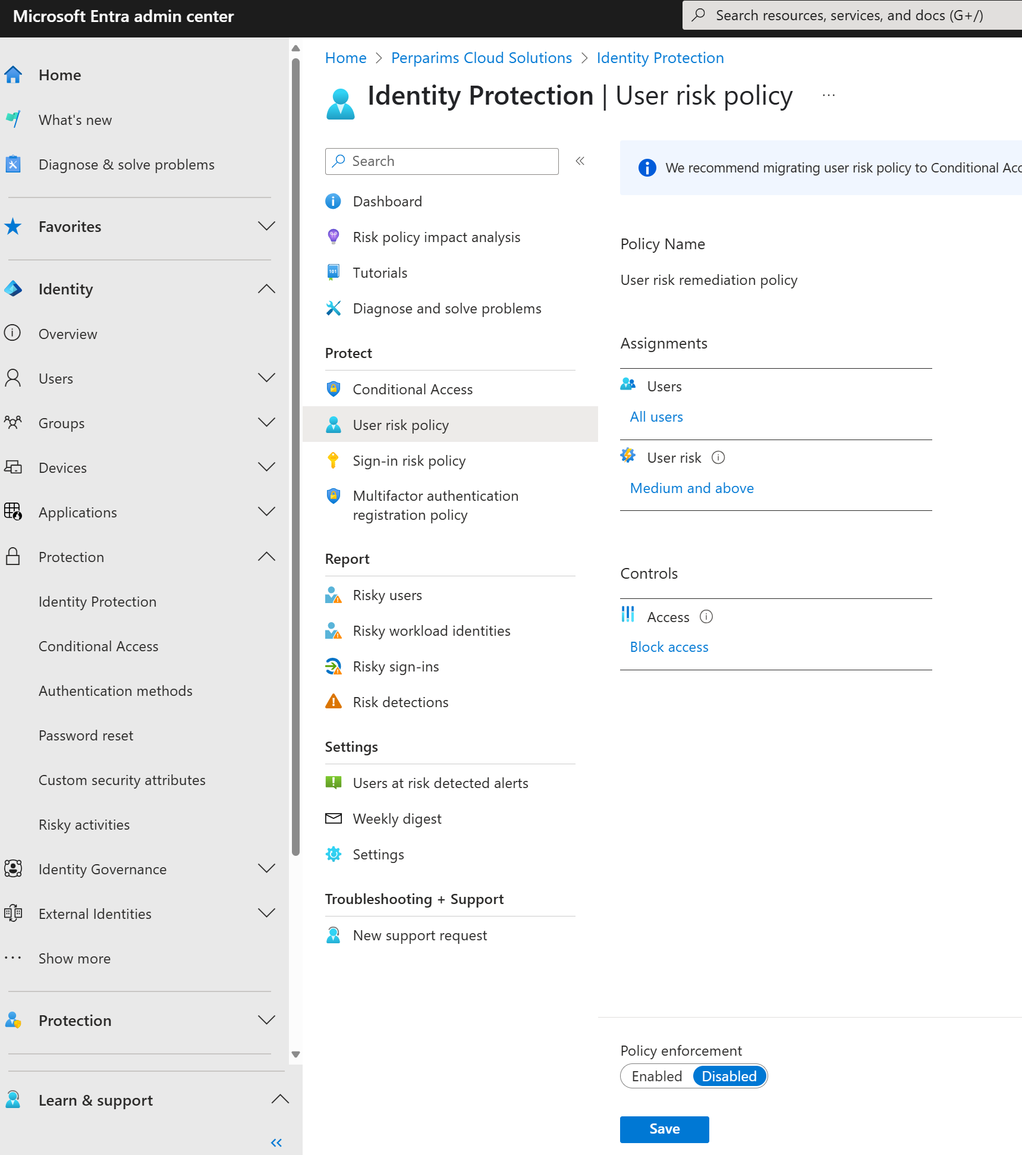
Creating the User Risk Policy
I created a User Risk Policy to block sign-in for users with Medium and above risk. You can scope this to all users or a test group.

Slide 5
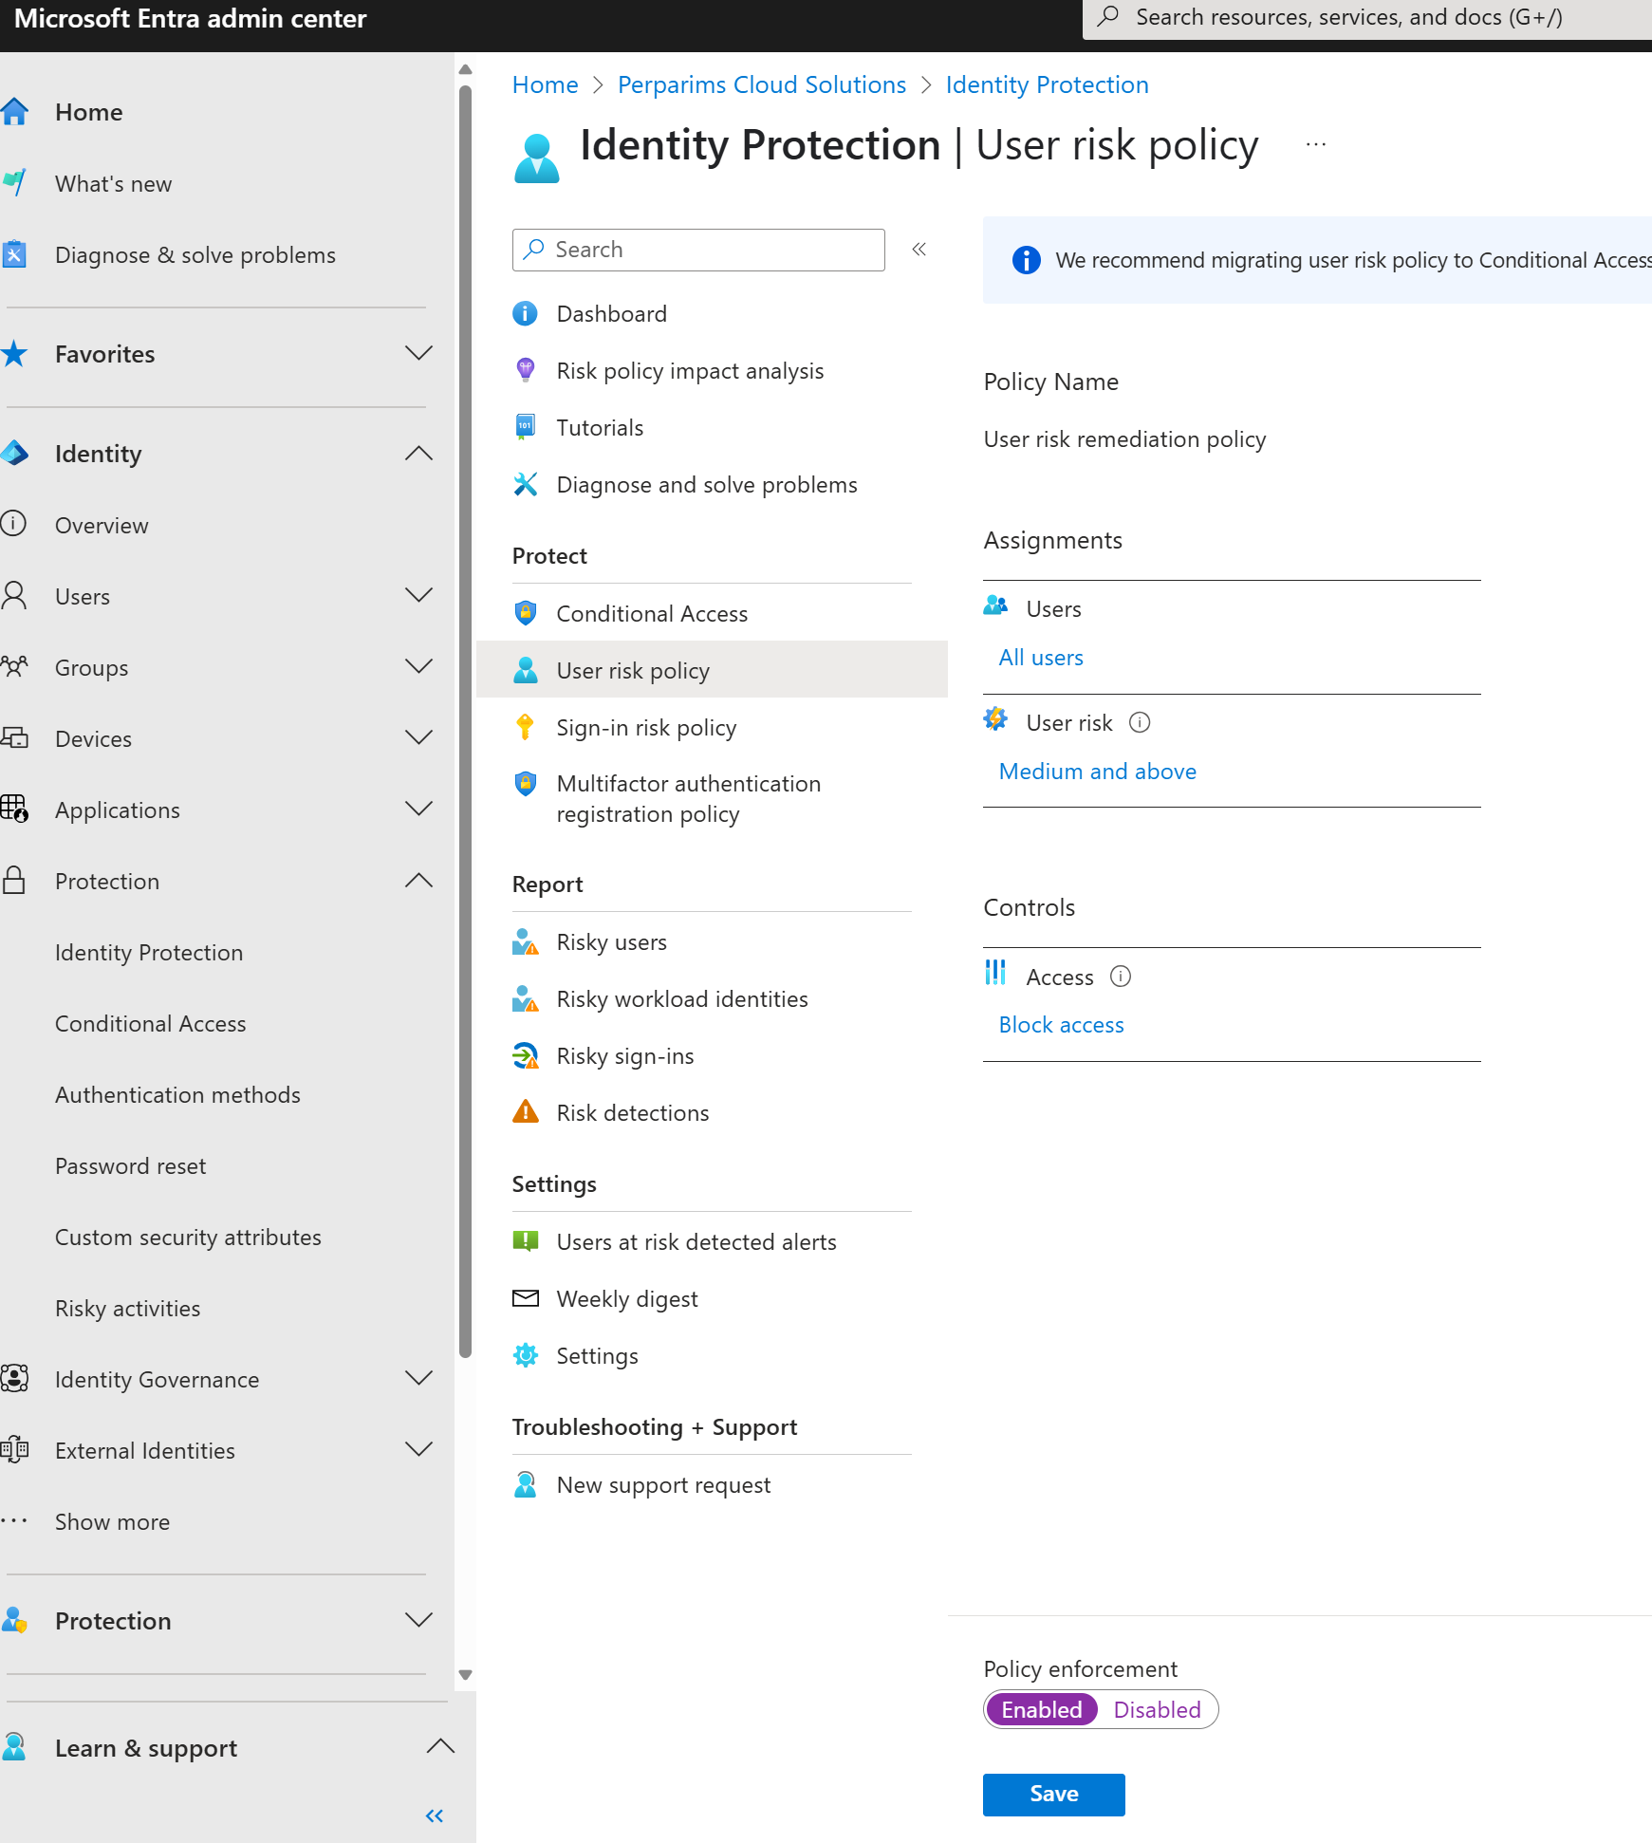
User Risk Policy Enabled
Policy enforcement switched to ✅ Enabled. Microsoft Entra will now automatically take action on risky users.

Slide 6
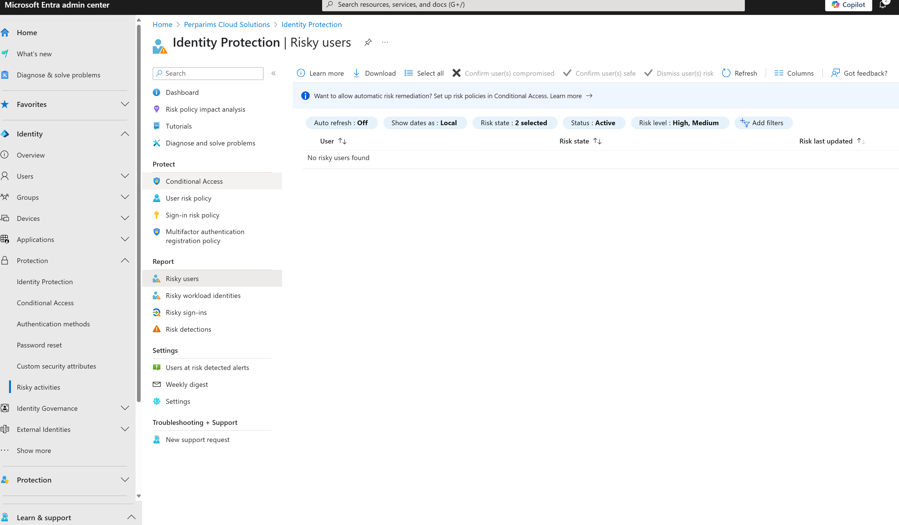
Monitoring Risky Users
This view shows users Entra has flagged as compromised. It updates in real time based on AI/ML detections. No risky users now — but protection is live.

Slide 7
Real-World Value
🎯 Protects accounts from takeover 🔐 Enforces Zero Trust policies ✅ Built into Microsoft Entra ID P2
Even without risky sign-ins in this lab, this demo shows how quickly you can configure real identity protection.

Slide 8
My Takeaway
Microsoft Entra ID Protection makes Zero Trust security easy to implement. With built-in ML and automated enforcement, I can stop threats before they escalate.
This is a must-know for SC-300, real-world Azure work, and client security demos.

